Slide 1
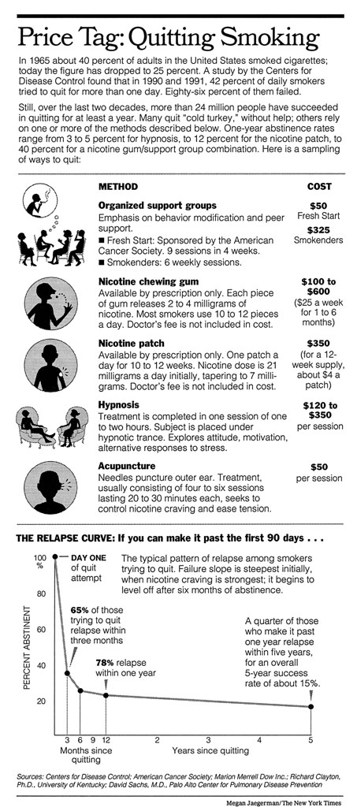

Slide 2

P peline
The Data
Information Visualization
© Jennifer Mankoff
The Data Pipeline; HCII; Spring 2014
Slides cribbed from Marti Hearst http://courses.ischool.berkeley.edu/i247/f05/ (slides 2-10, 16, 19-21, 23, 25-37); Jian Huang, based on a tutorial by Daniel Kiem (slides 39-58); Beomjin Kin (11-14, 17-18)

Slide 3
Goals for today
Talk Narrative
Finish D3
Review ‘Quiz’
Another Quiz
Discuss Byte 4
Possible case study

Slide 4
Definition of Narrative
“an account of a series of events, facts, etc., given in order and with the establishing of connections between them.”
-- Oxford English Dictionary
Beginning, Middle, End: Conflict & Conflict Resolution

Slide 5
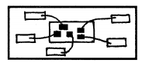
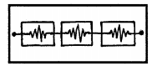
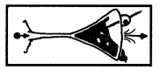
Approaches (a spectrum)
Author Driven | Reader Driven
Linear ordering | No prescribed order
Heavy messaging | No messaging
No interactivity (?) | Free interactivity
Drill Down Story Interactive Slideshow Martini Glass

Slide 6
Narrative Tactics
Visual Structures (establishing shot, checklist, consistent visual platform)
Highlighting (color, motion, framing, size, audio, and more) – relates to last Tuesday’s perceptual characteristics
Transitions (McCloud; animation principals; etc)

Slide 7
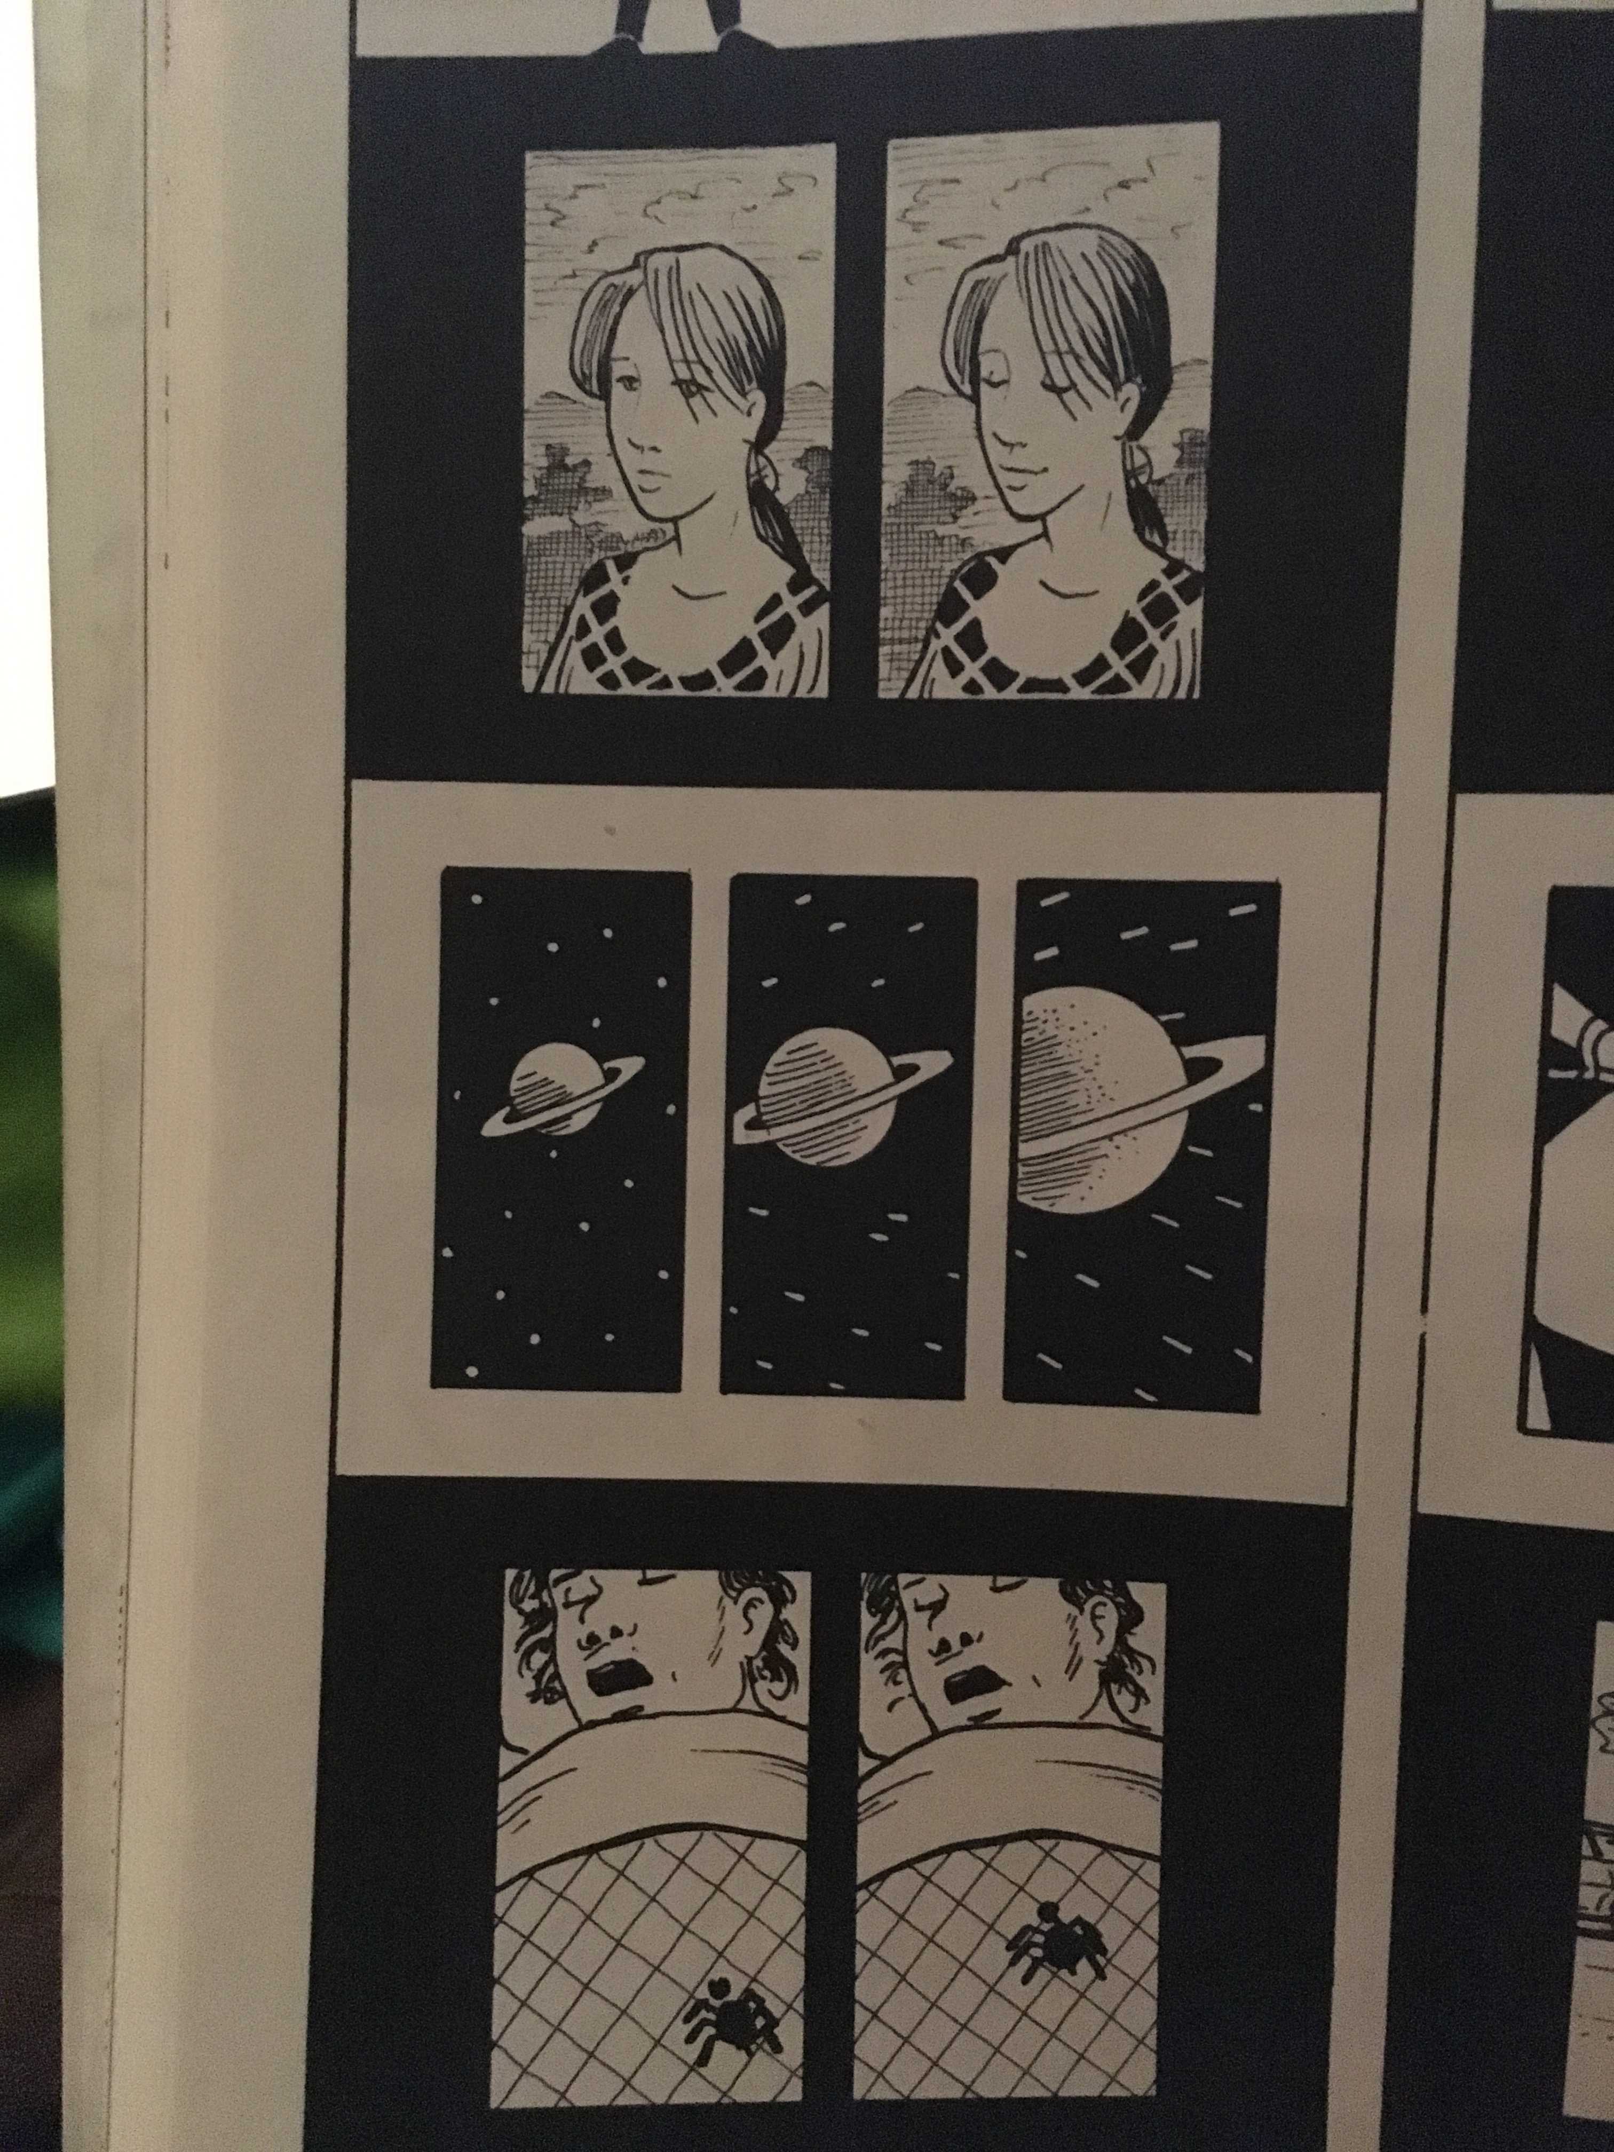
McCloud: Moment To Moment
Notes:
One subject, short time

Slide 8
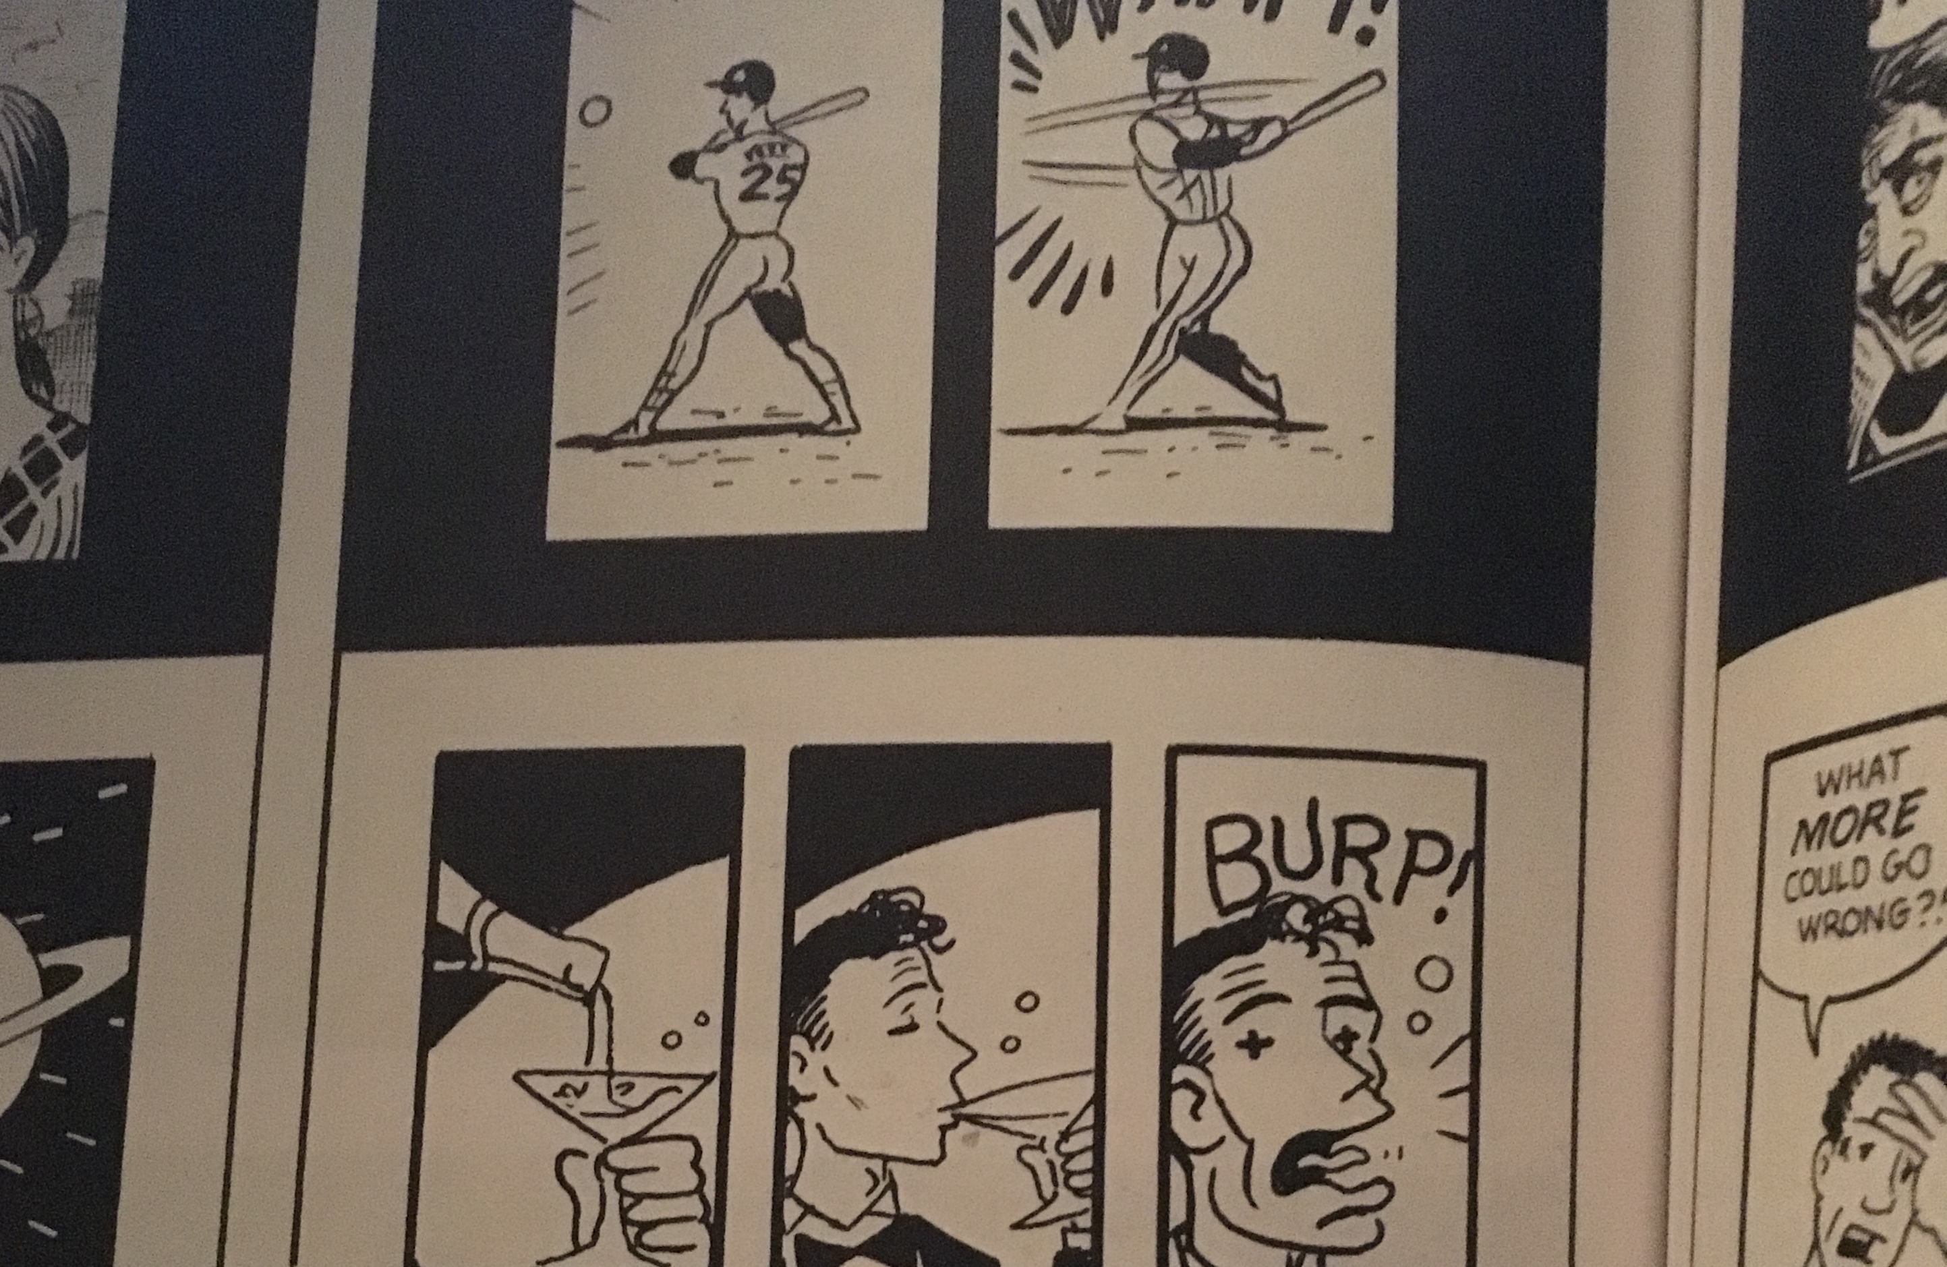
McCloud: Action To Action
Notes:
One subject, longer time

Slide 9
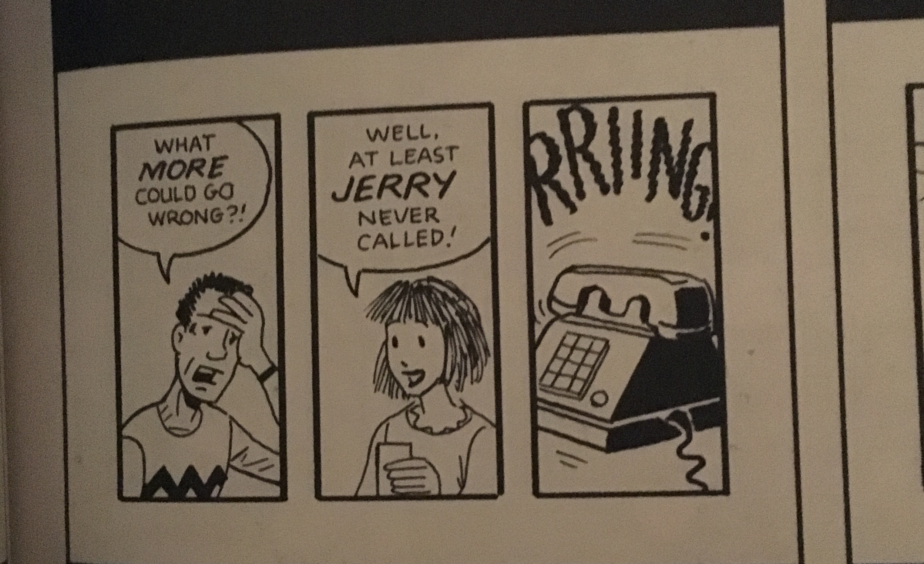
McCloud: Subject To Subject
Notes:
Different Subjects, Same scene

Slide 10
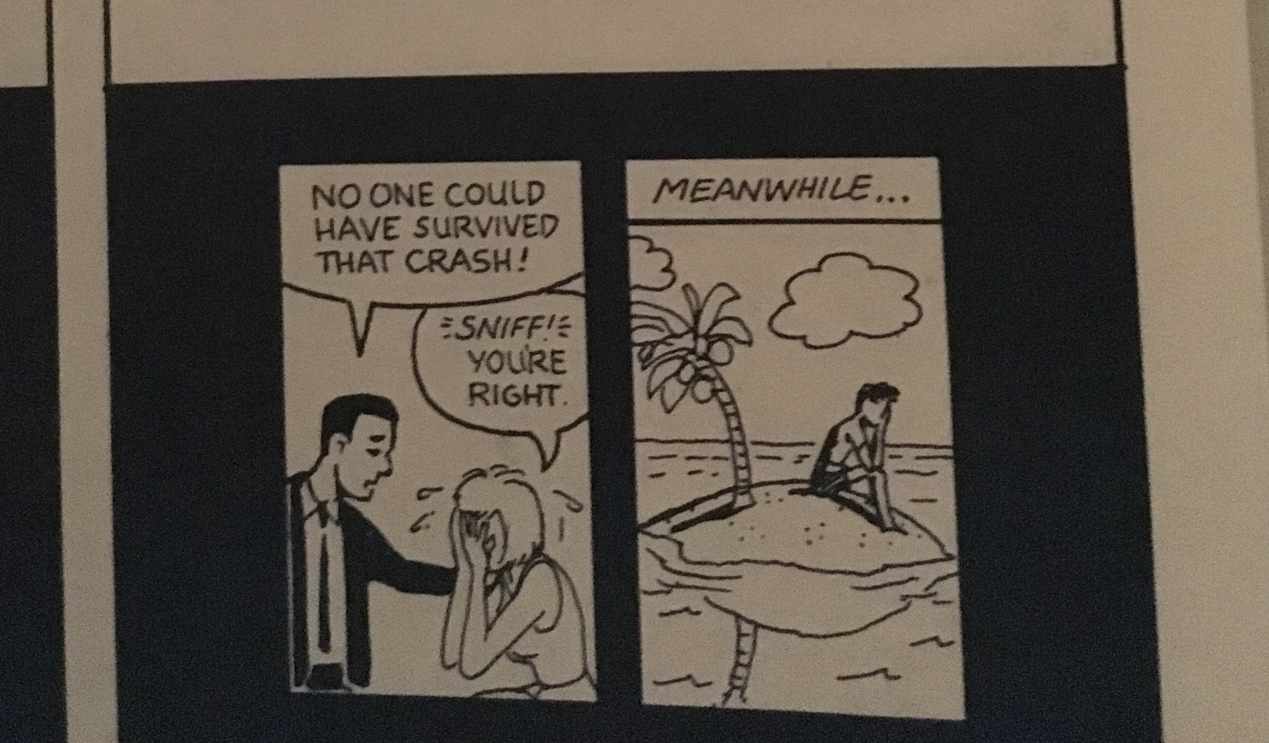
McCloud: Scene To Scene
Notes:
Different Subjects, Same scene

Slide 11
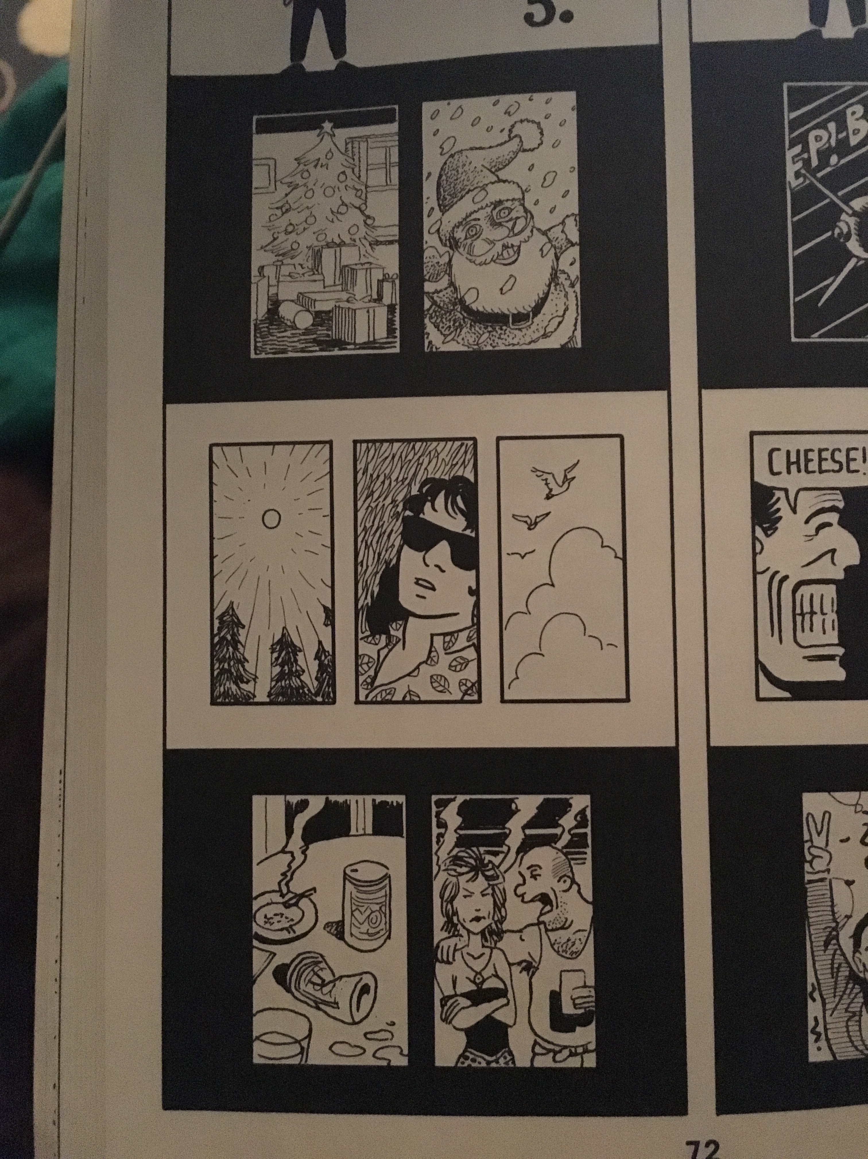
McCloud: Aspect To Aspect
Notes:
Different aspects of a place, idea, mood

Slide 12
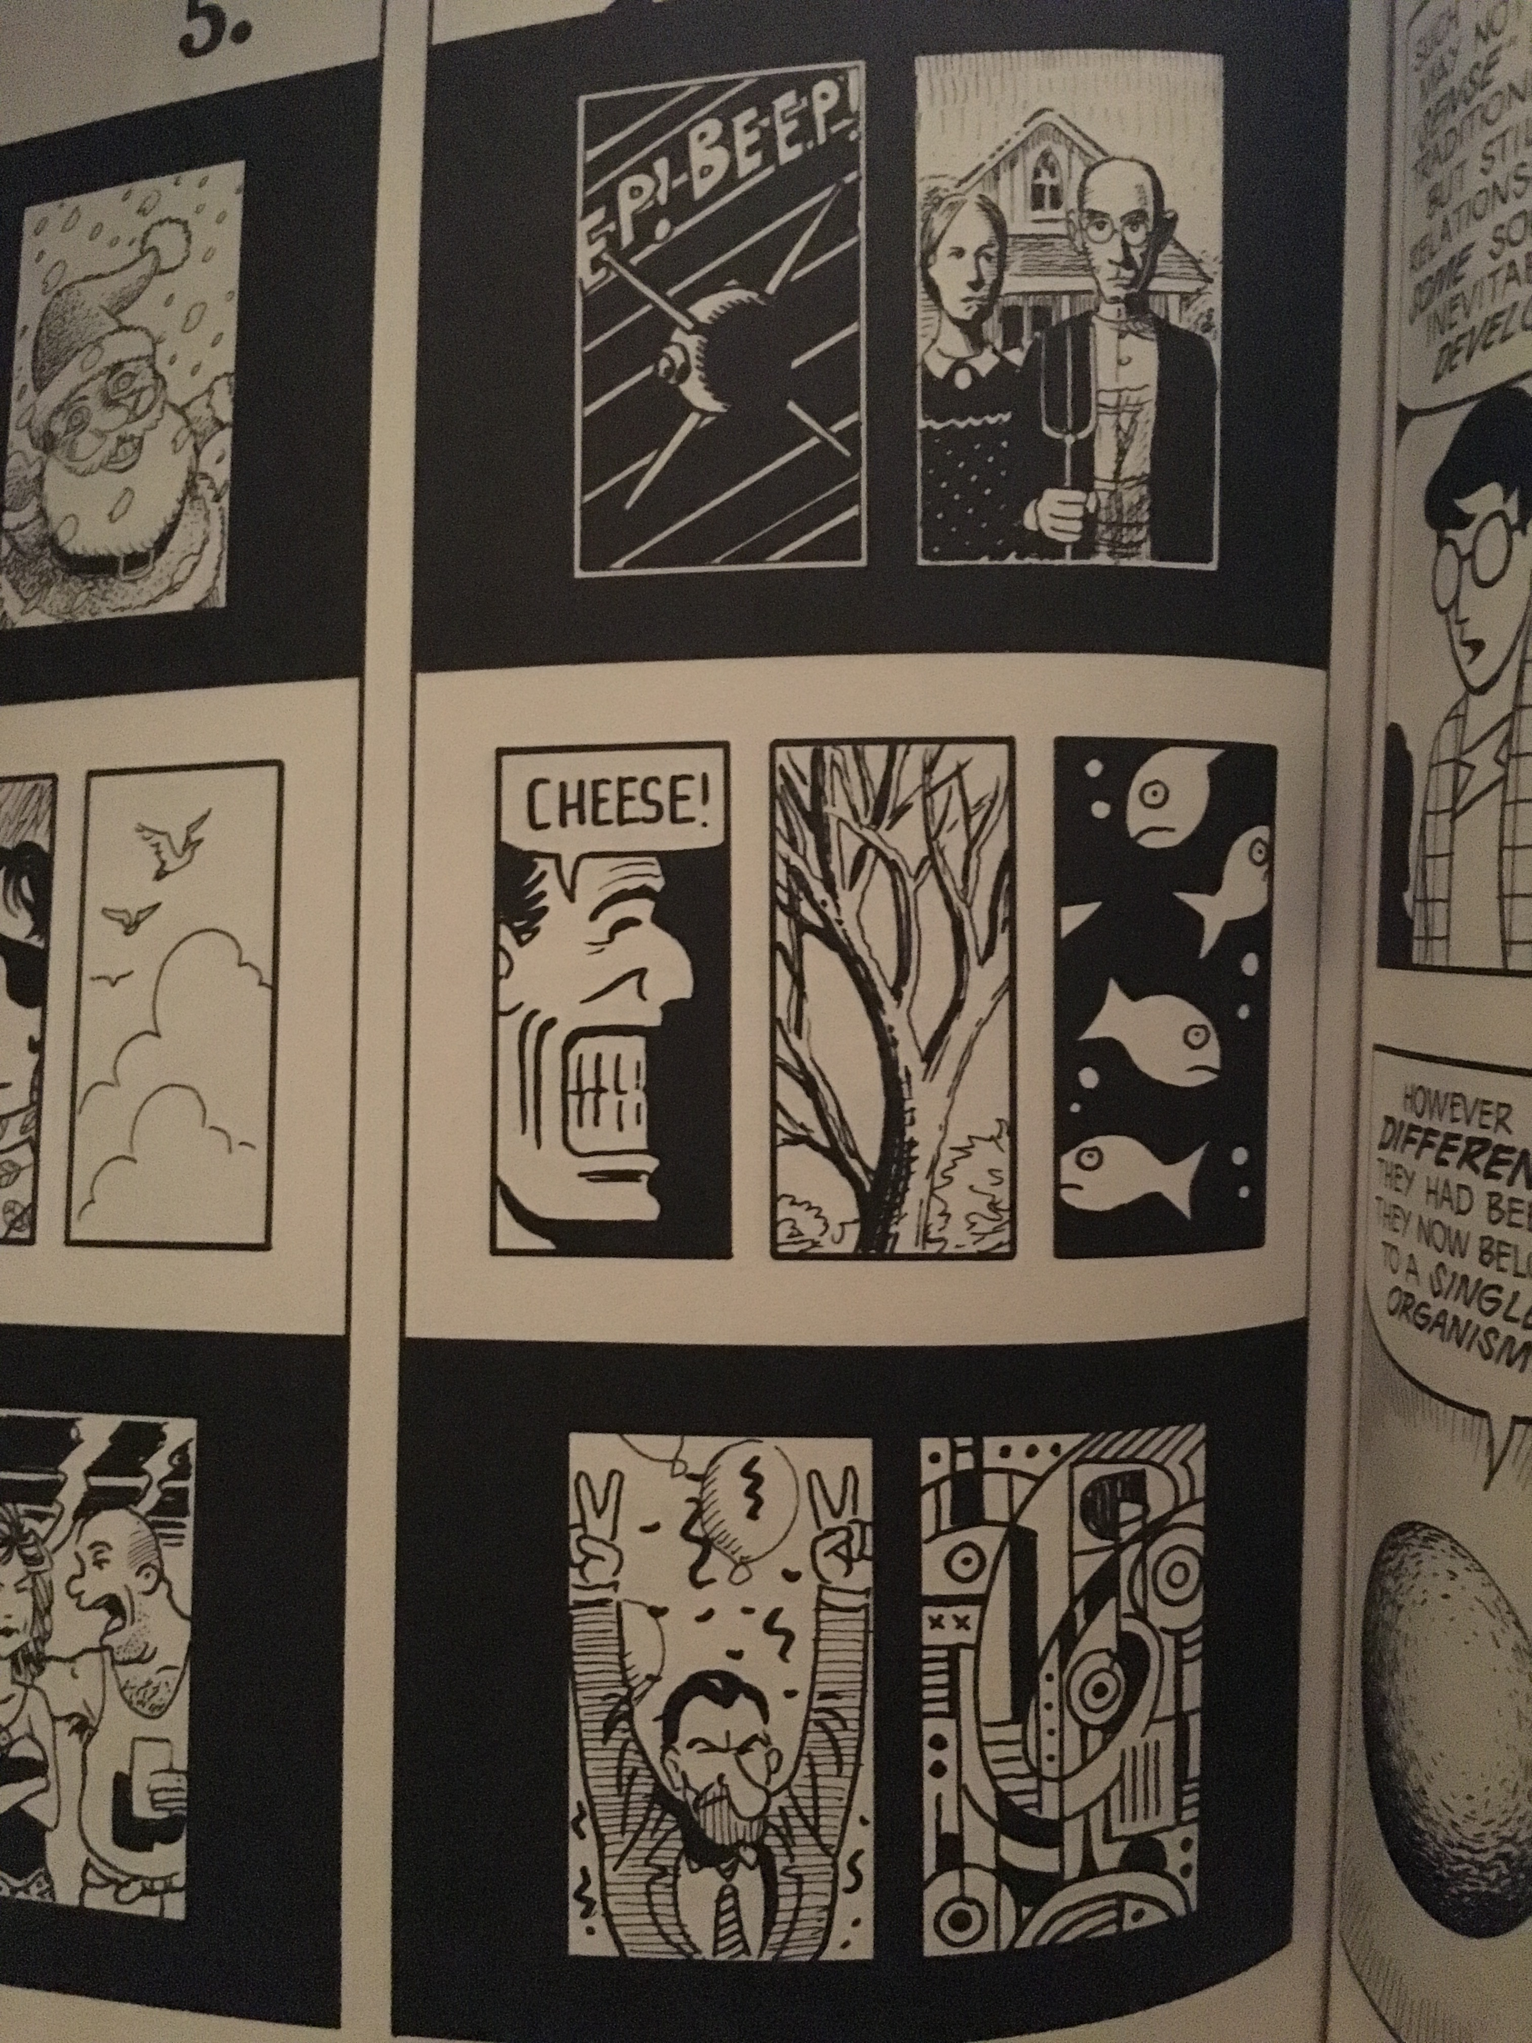
McCloud: Non Sequitur
Notes:
Different aspects of a place, idea, mood

Slide 13
Narrative Structure
Ordering (author vs viewer driven; etc)
Messaging (use of text)
Interactivity

Slide 14
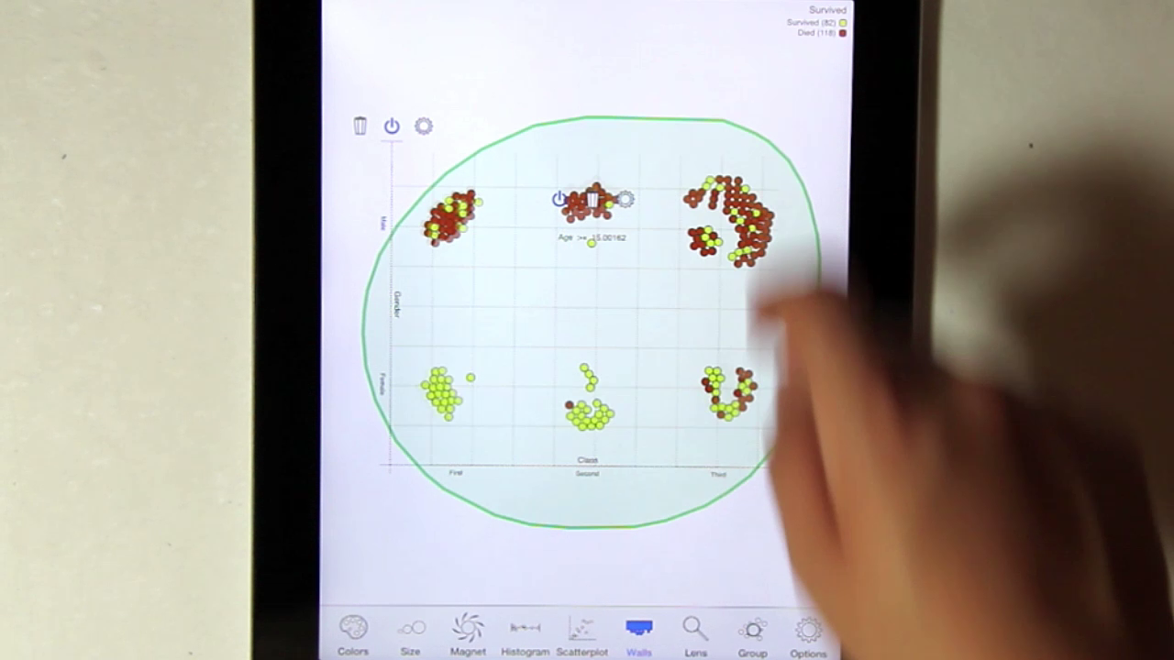
Rzeszotarski & Kittur: Kinetica: Dynamic Exploration
Notes:
We found that physics-based interactions helped users explore multiple dimensions at once, make more descriptive and comparative findings about their data, and develop a more holistic understanding of a dataset. We invited 16 participants to use the software for 45 minutes in a lab study. As a comparison case, we also invited another group of 16 participants to follow the same study protocol using Excel rather than the application. Interestingly, Kinetica users made far more descriptive, comparative, and relationship findings than their Excel peers who almost always made point or statistical findings (Figure 7; c²(5)=31.3, p<0.001).

Slide 15
Interactivity Options
Data & View Specifications | Visualize (choose encoding) Filter (focus on relevant items) Sort (expose patterns) Derive values or models
View Manipulation | Select (to highlight, filter, or manipulate) Navigate (zoom to examine patterns & detail) Coordinate (linked exploration) Organize windows and workspaces.
Process & Provenance | Record analysis histories Annotate patterns to document findings. Share views and annotations Guide users through analysis tasks or stories.
Heer & Shneiderman: Interactive Dynamics for Visual Analysis; ACM QUEUE, Feb 20, 2012
Notes:
Xx http://flowingdata.com/2016/01/19/how-you-will-die/
Tailor to the application and the domain
Create highly interactive and integrated systems
Embed the visualization within a larger application
Provide alternative views

Slide 16
Holistic Design Goals
Data & View Specifications | Visualize (choose encoding) Filter (focus on relevant items) Sort (expose patterns) Derive values or models
View Manipulation | Select (to highlight, filter, or manipulate) Navigate (zoom to examine patterns & detail) Coordinate (linked exploration) Organize windows and workspaces.
Process & Provenance | Record analysis histories Annotate patterns to document findings. Share views and annotations Guide users through analysis tasks or stories.
Heer & Shneiderman: Interactive Dynamics for Visual Analysis; ACM QUEUE, Feb 20, 2012
Notes:
Annotate older: http://www.nytimes.com/interactive/2012/09/20/world/africa/the-attack-on-the-american-mission-in-benghazi-libya.html
Sort older: http://www.nytimes.com/interactive/2012/09/14/us/how-the-chicago-public-school-district-compares.html?_r=0
Filter older: http://dataviz.rennesmetropole.fr/quisommesnous/index-fr.php
Coordinate older: http://www.nytimes.com/interactive/2012/08/24/us/drought-crops.html

Slide 17
Narrative framing choices
Omission vs Filtering
Metonymy (omitting whole variables)
Ambiguity (in definitions)
Thresholding (e.g. chart values)
Provenance
Accountability (as discussed)
Uncertainty (e.g. error bars; confidence intervals; discussion of limitations)

Slide 18
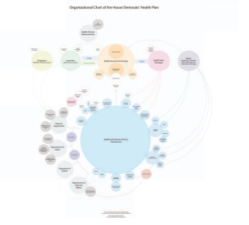
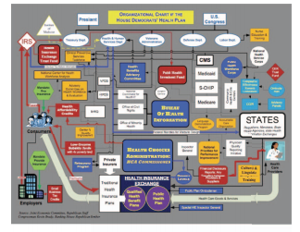
Narrative framing choices
Obscuring
Notes:
Democratic health plan…

Slide 19
Narrative framing choices
Obscuring
Leveraging Perceptual effects (from last Tuesday) to imply things whether or not correct
Using redundancy to emphasize
Using grouping
Contrast
…
Using Linguistic effects (irony, metaphor, etc)
Notes:
Democratic health plan…

Slide 20
Goals for today
Talk Narrative
Possible case study

